Slide 1

Project Title: DVIS: A Wearable Deep Vascular ID System
Nano Computing Research Group

Slide 2
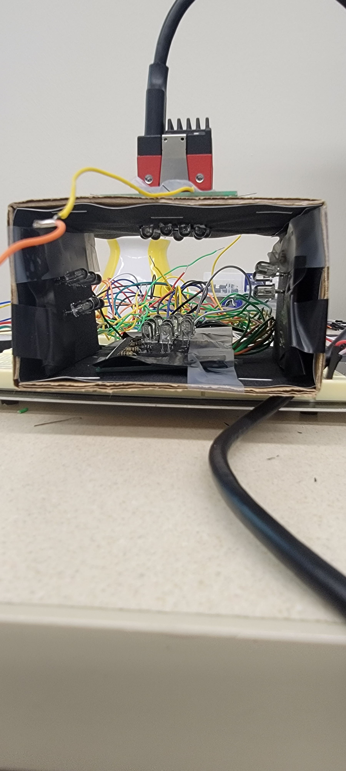
IR Imaging Setup Progress
IR image setup using High power LEDs (870nm)
New setup to capture IR images for both reflected and refracted rays, LEDs touching the skin with high intensity of IR light from IR LEDs focusing on all the four sides of the hand

Slide 3
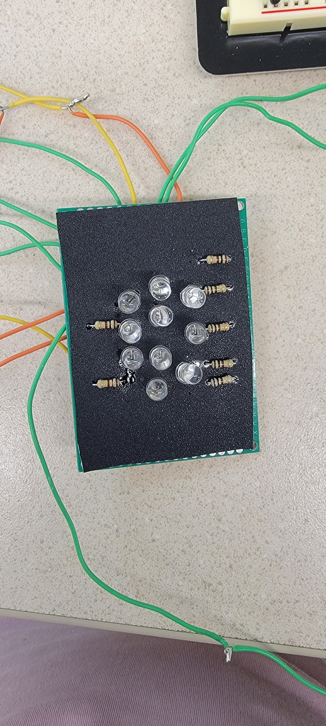
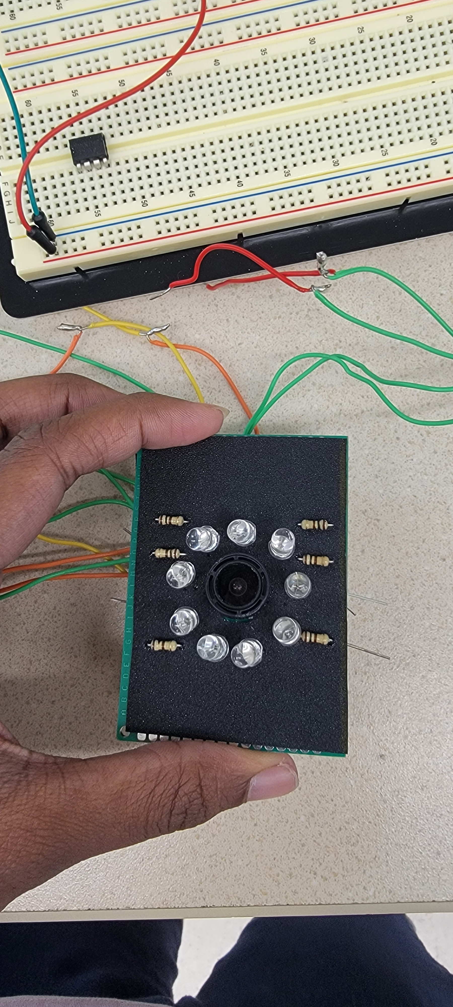
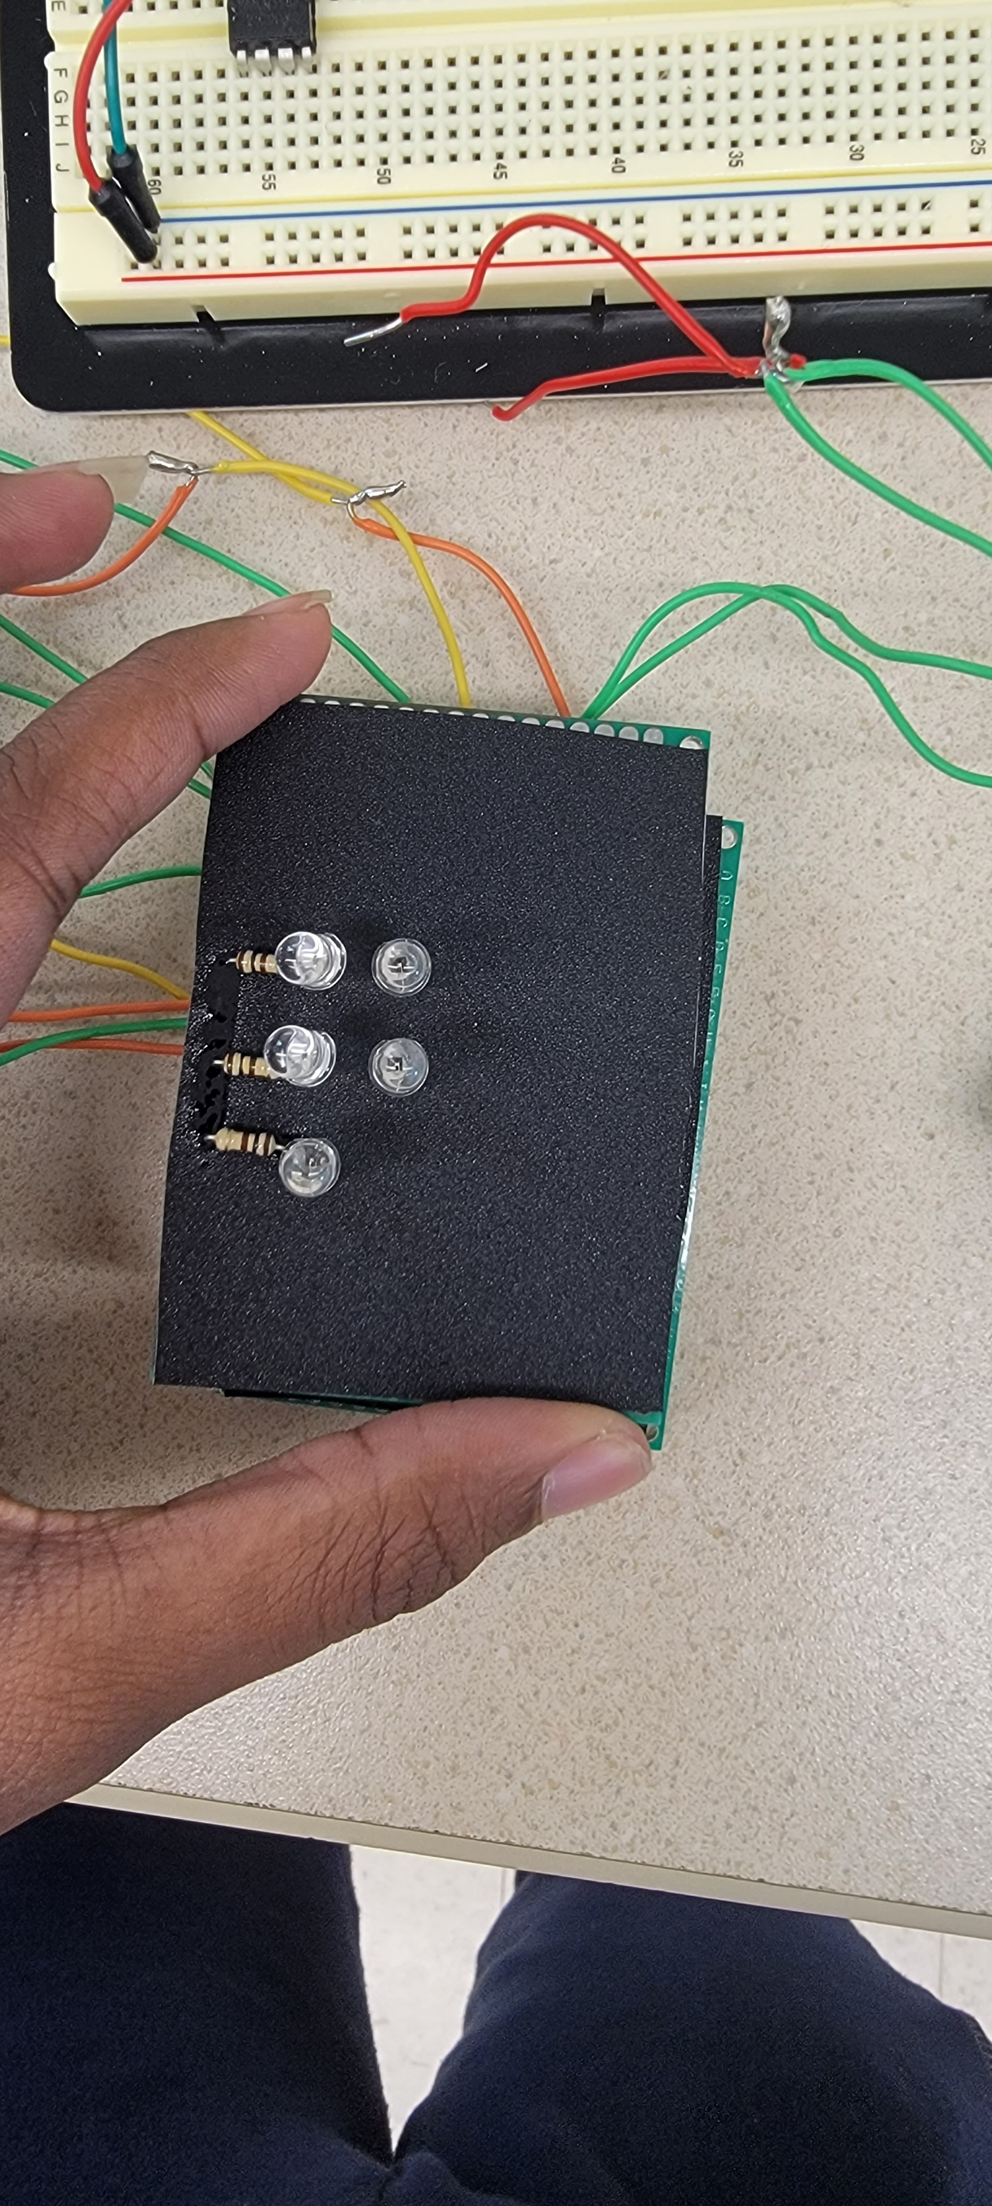
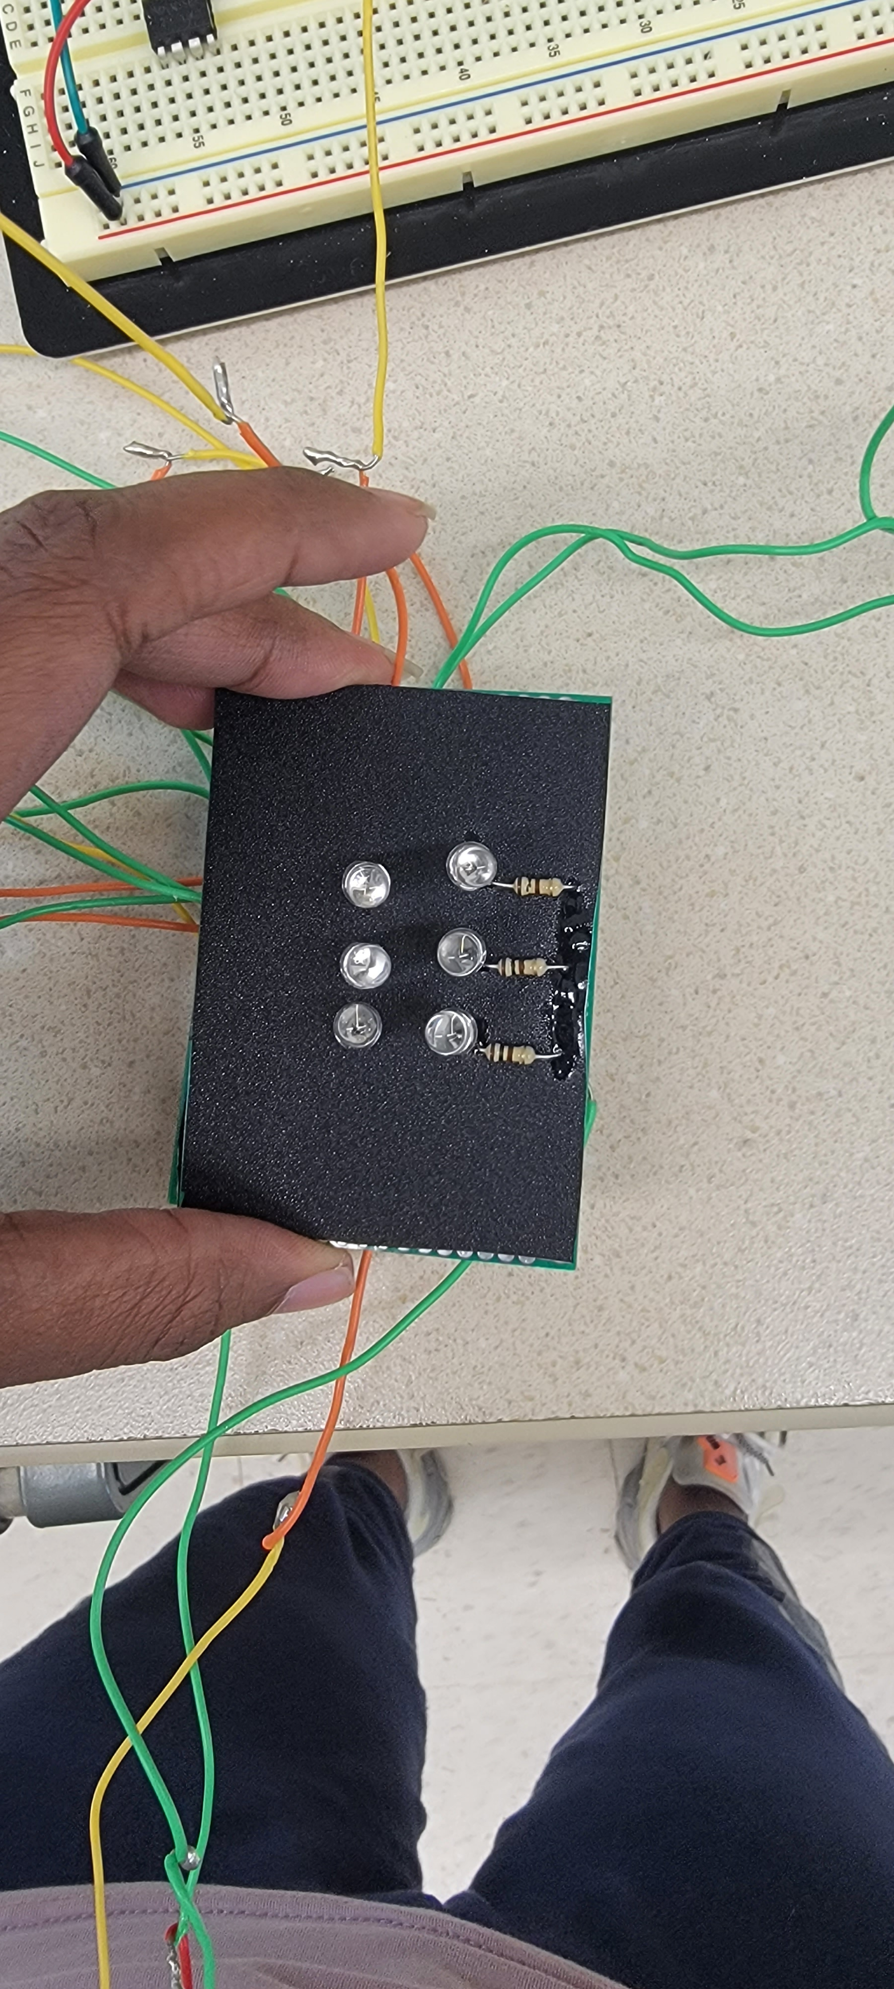
Zones in hardware setup
Zone 3 top side of the hand
upper view of the setup with a hole for camera on the bottom side to capture IR images
Zone 1 bottom side of the hand
Zone 2 left side of the hand
Zone 4 right side of the hand

Slide 4
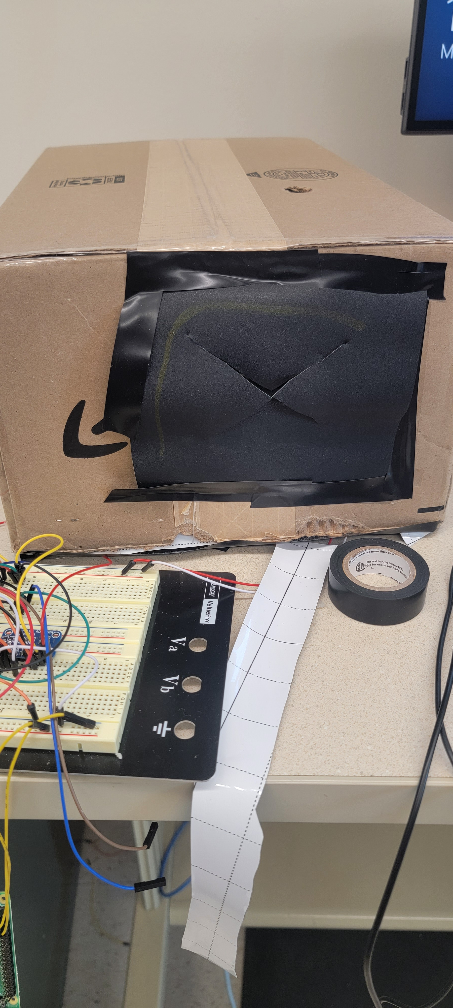
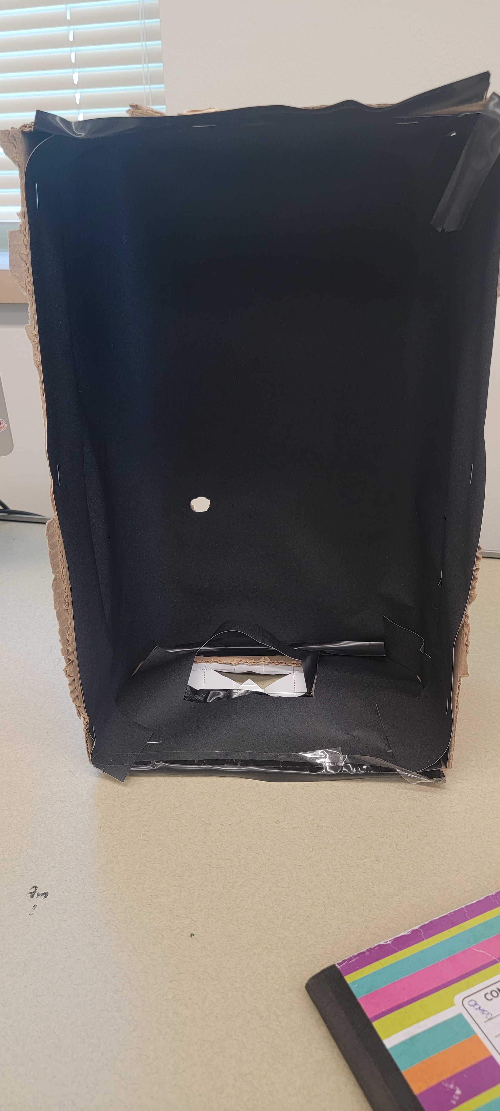
Setup to prevent ambient light
Inner view of the box
Curtain to the box(to insert hand)
Black film wrapped inside a box and an opening on one side
IR image setup is placed inside box to avoid ambient light from external

Slide 5
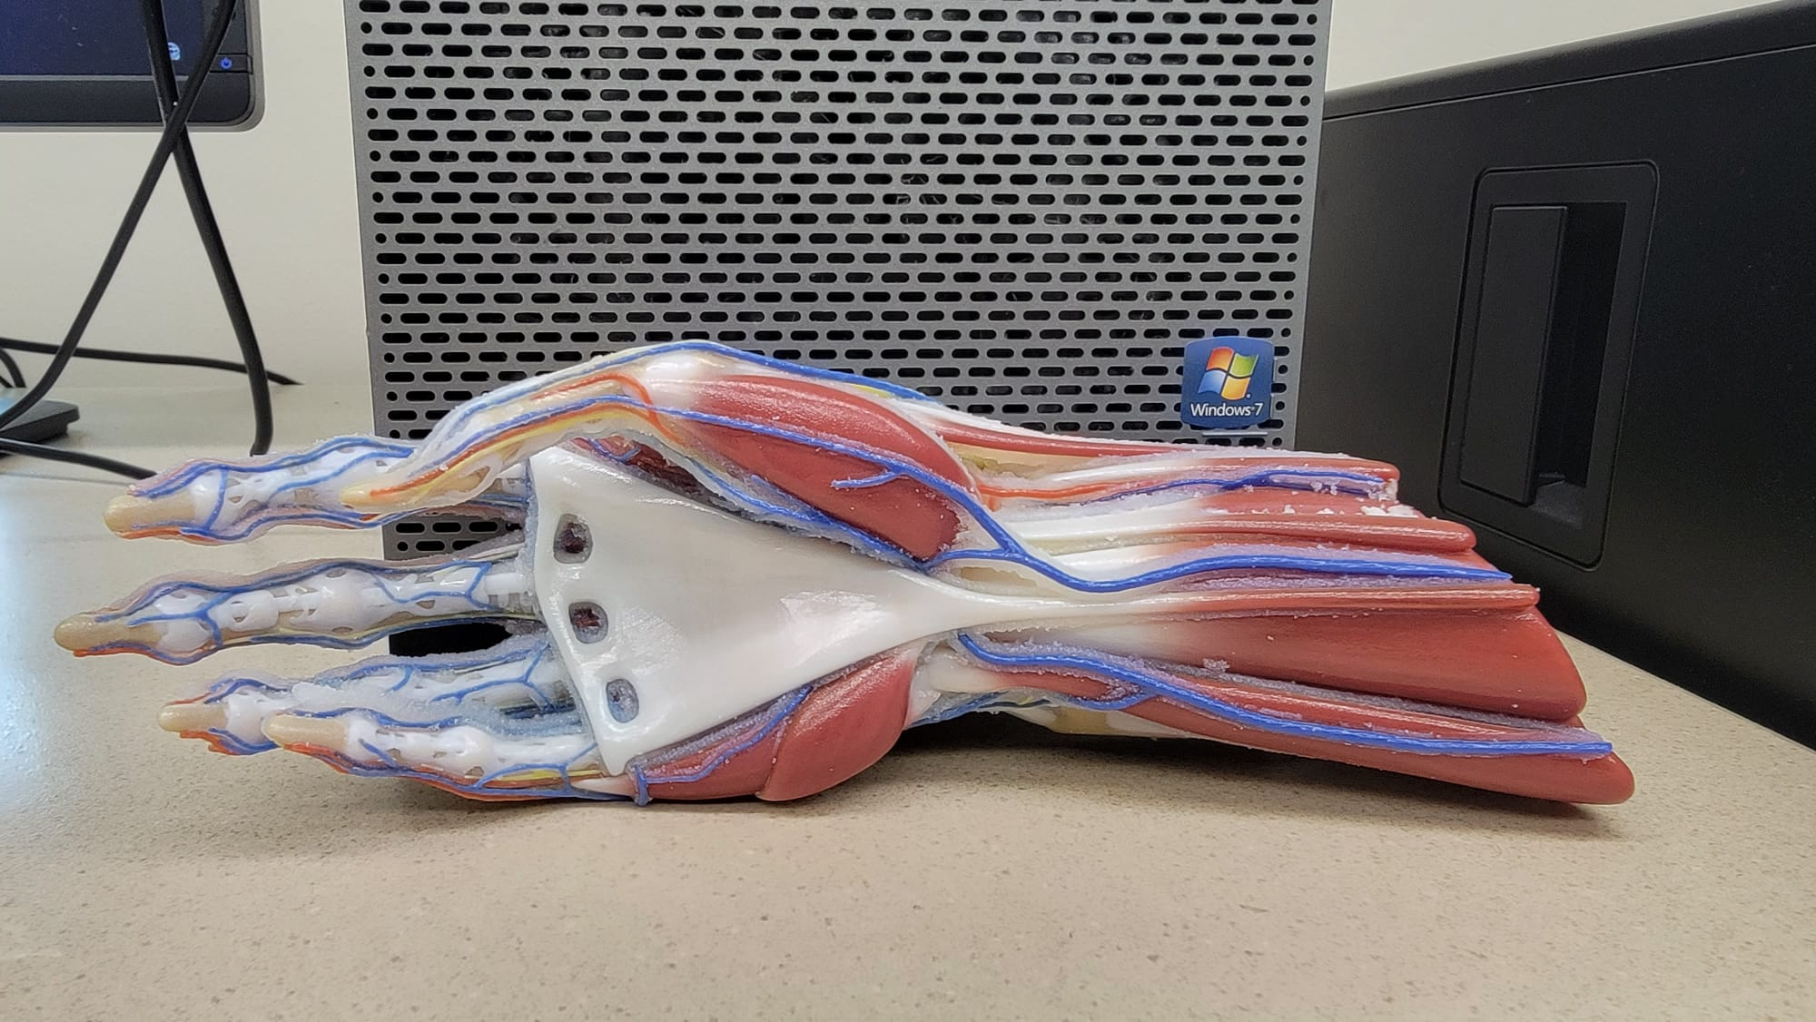
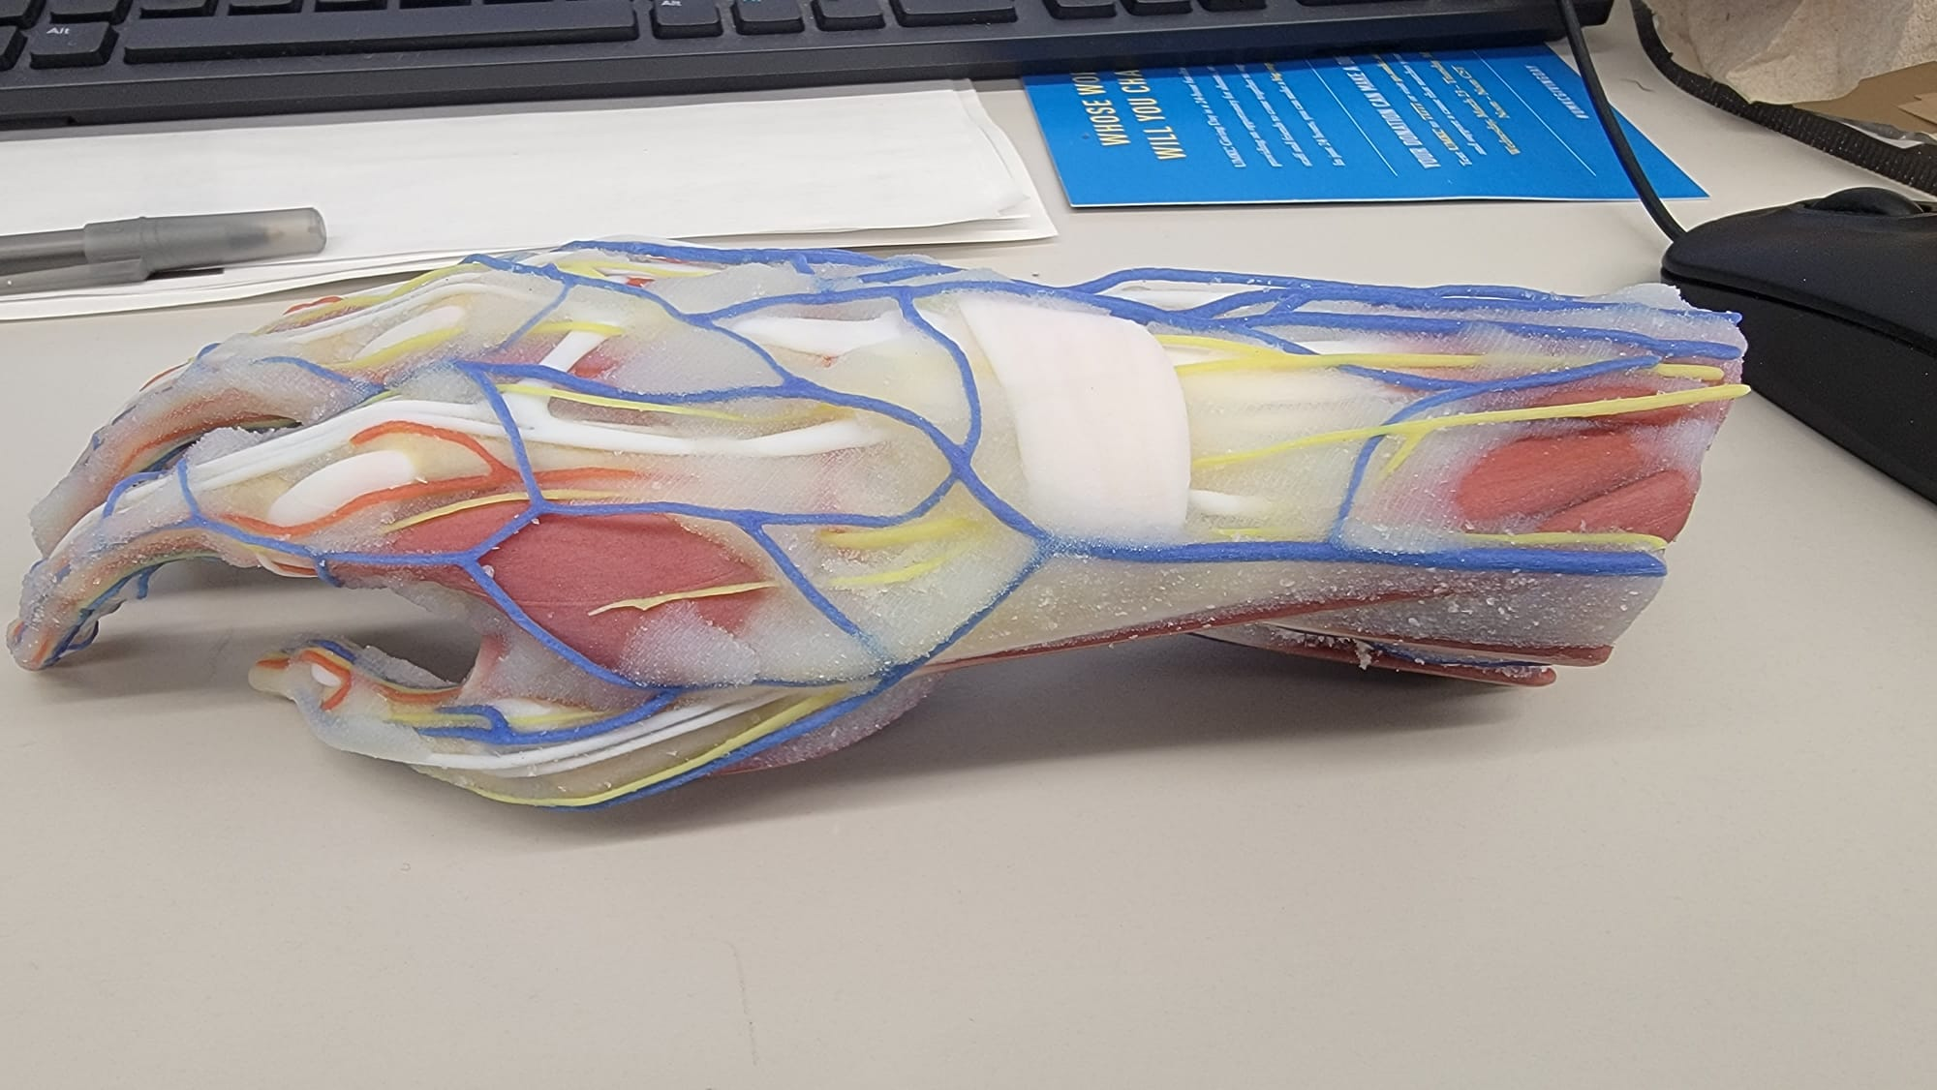
Phantom:
The 3D printing of the wrist was done using an off-the-shelf model of hand from sketchfab.com.

Slide 6
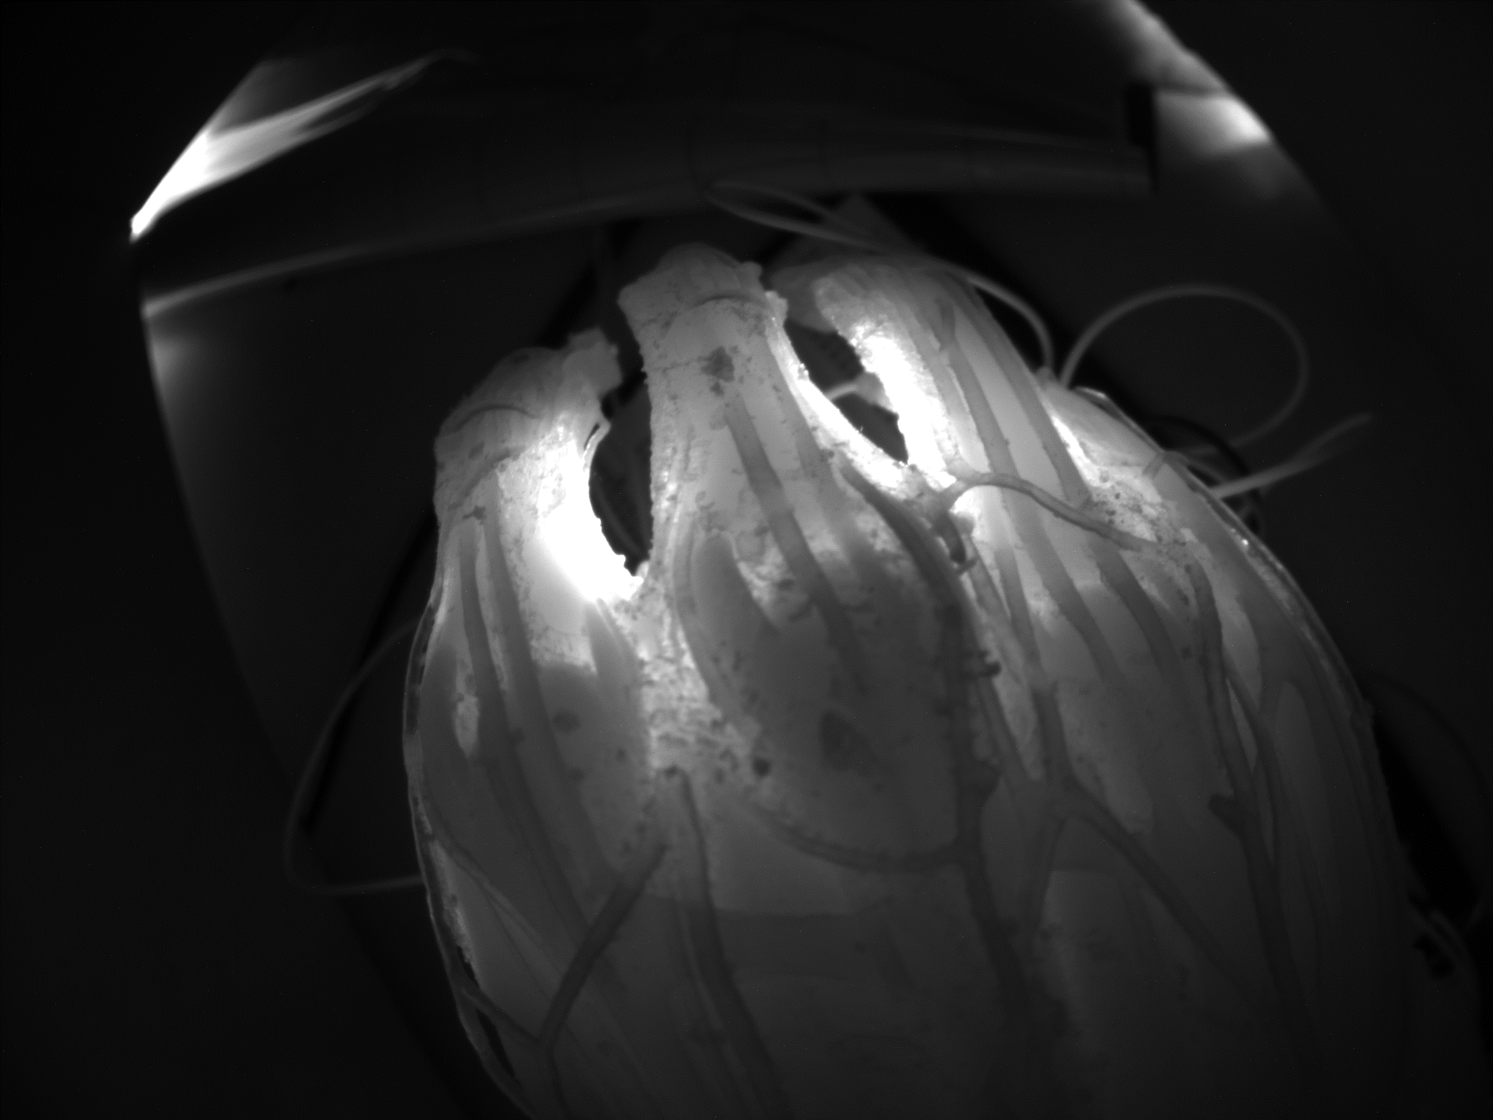
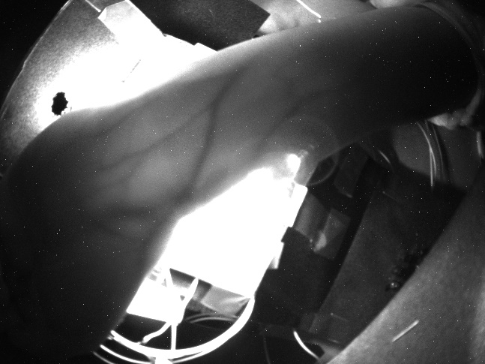
NIR Captured Images – Phantom
Exposure: 47498.609 µs Gain: 12.8dB
Exposure: 759912.957 µs Gain: 7.2dB
Veins
Phantom Wrist model
Human Wrist at 90 degrees
IR images of wrist and Phantom model taken in dark environment.

Slide 7
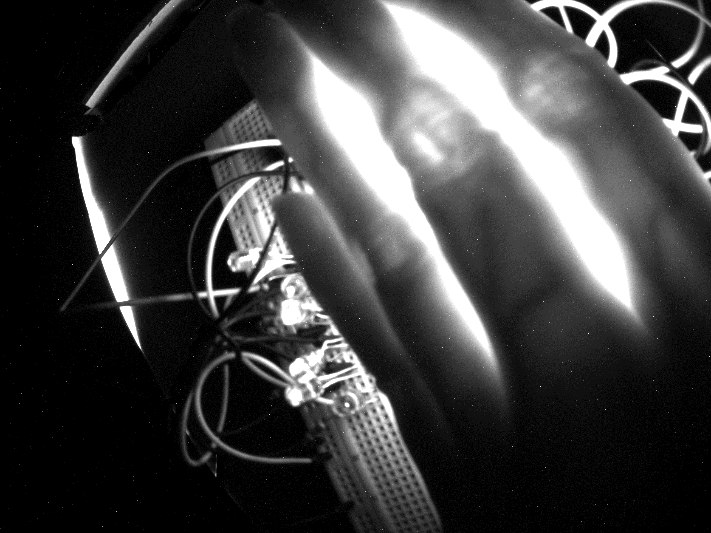
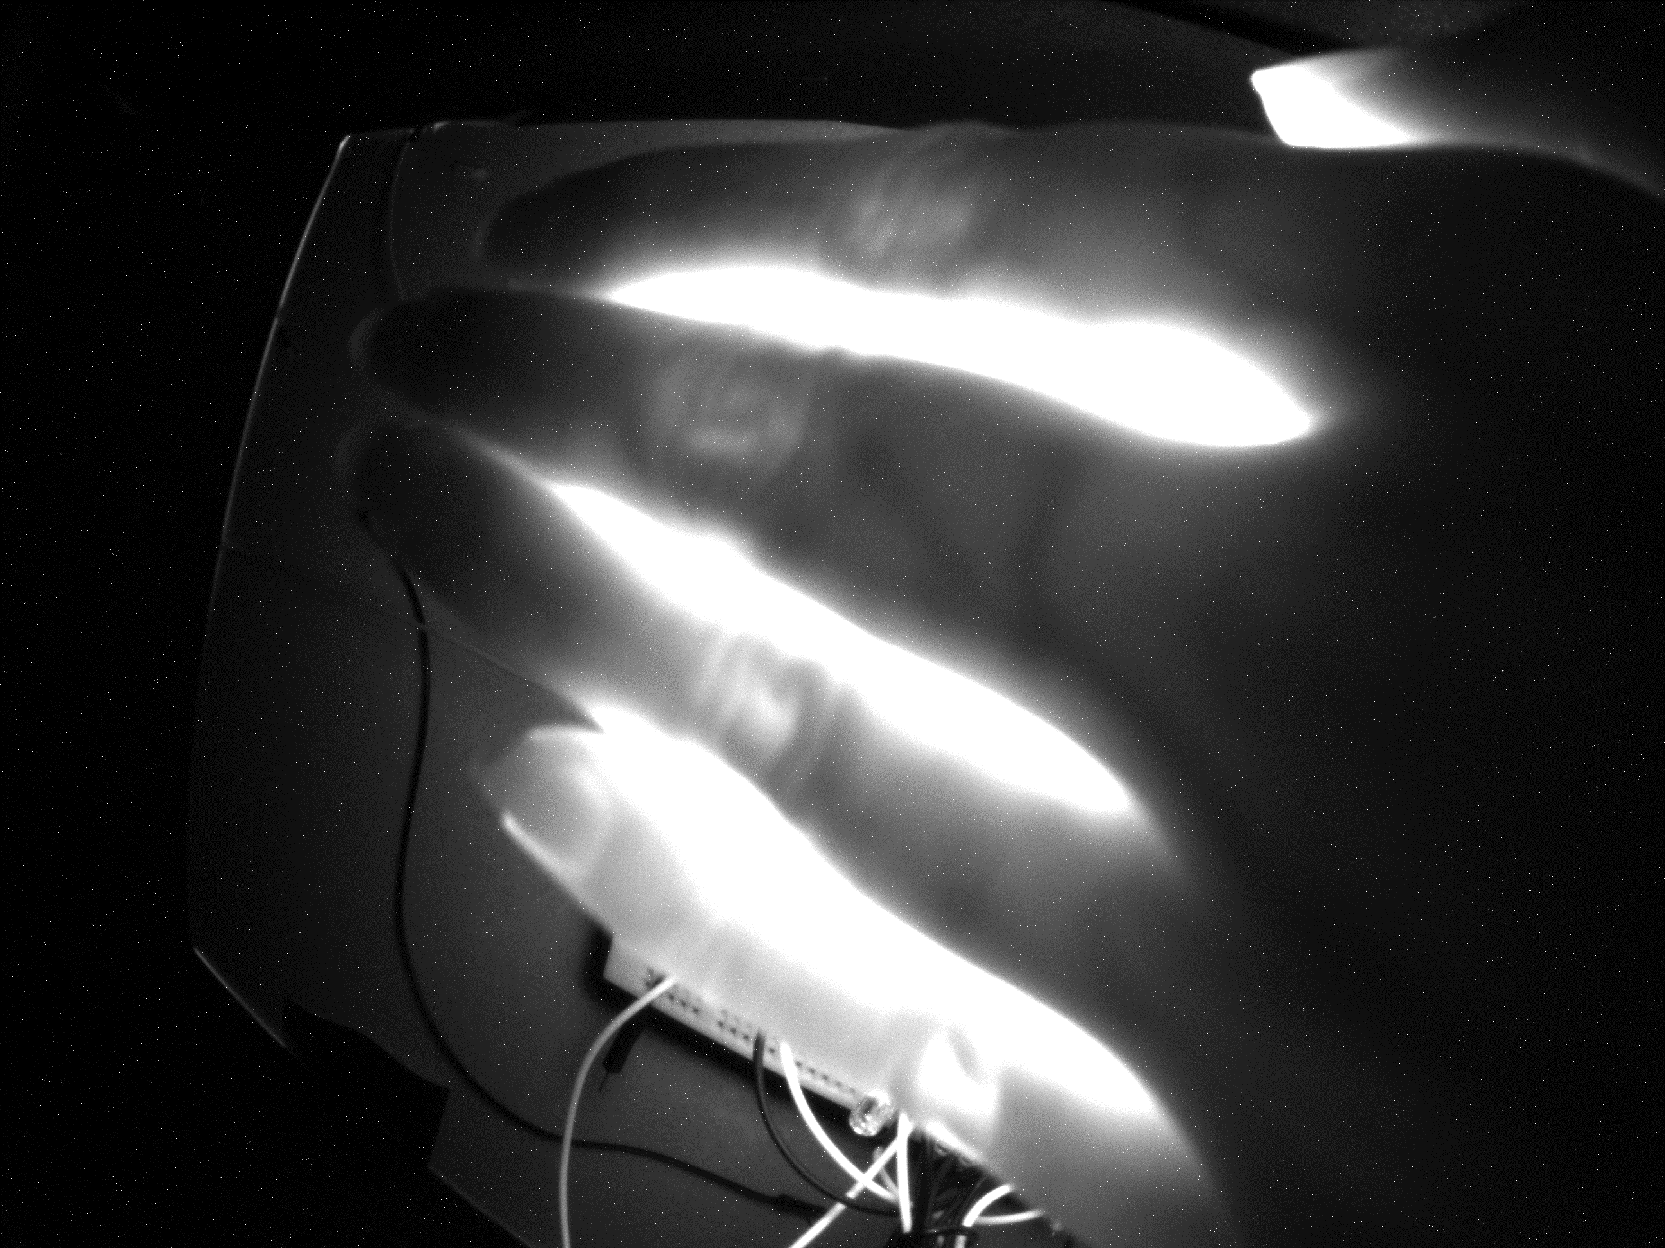
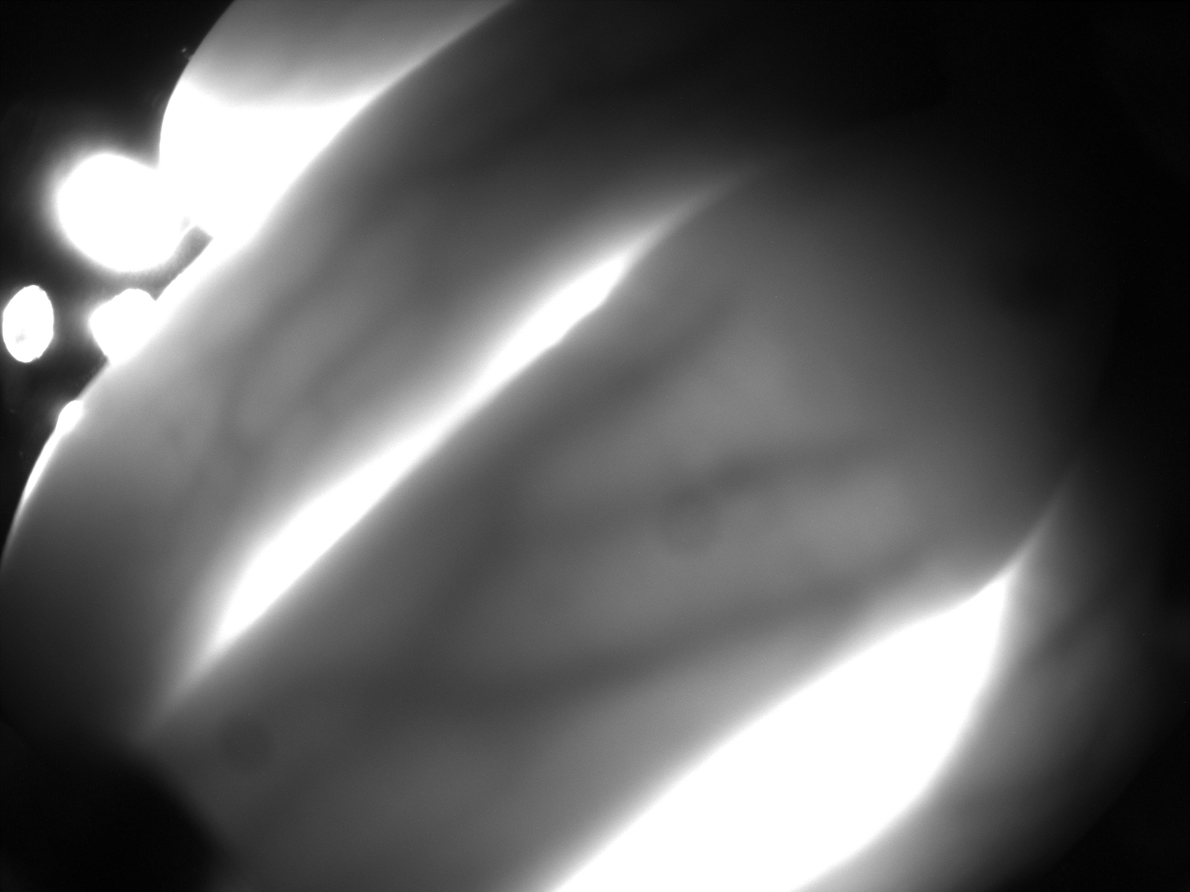
NIR Captured Images - Fingers
Veins
Exposure: 849040.870 µs Gain: 7.2dB
IR images of wrist taken in a dark environment captured at various angles of the fingers

Slide 8
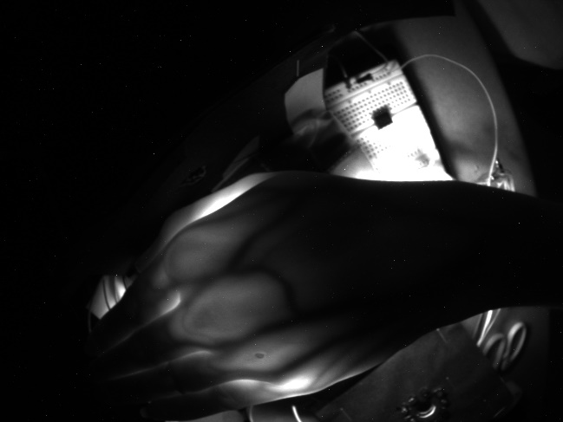
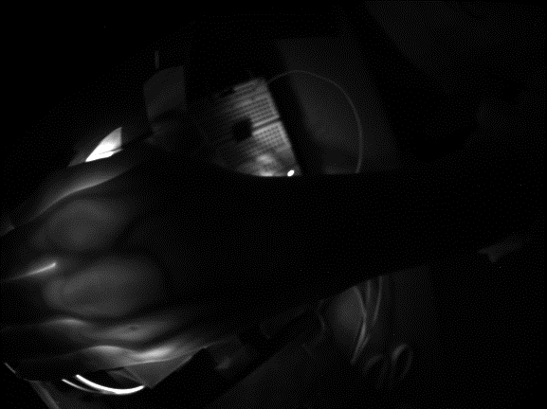
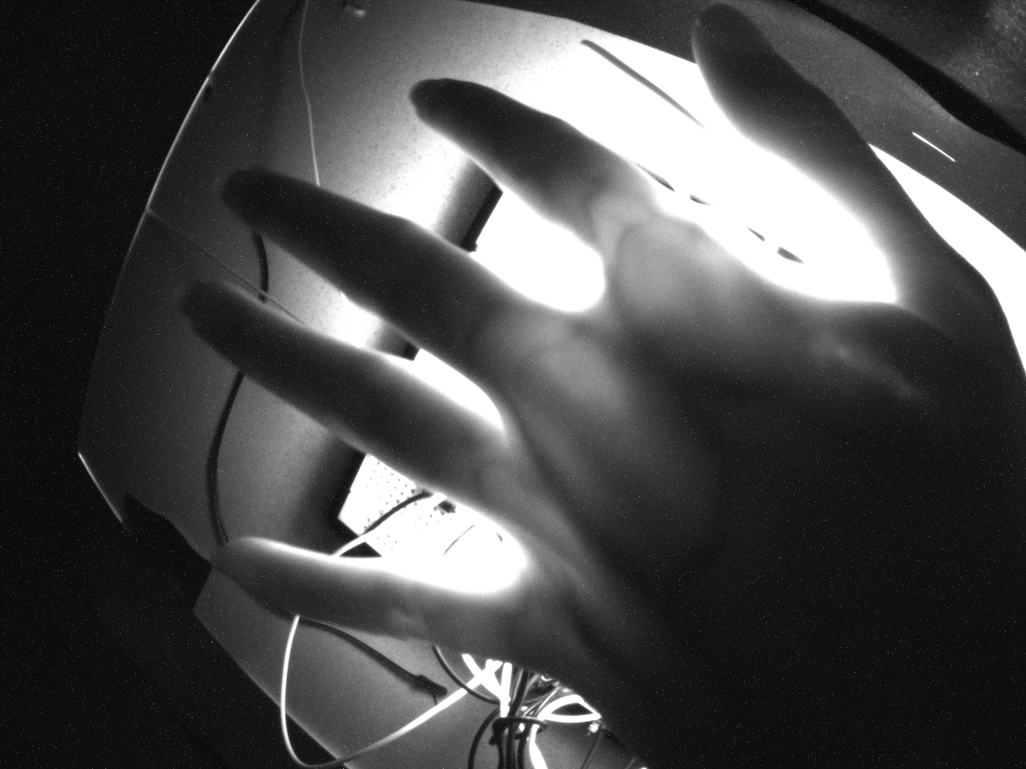
NIR Captured Images - Palm
Exposure: 849040.870 µs Gain: 16.8dB
Veins
IR images of the wrist captured with various angles at different exposure levels & Gain values

Slide 9
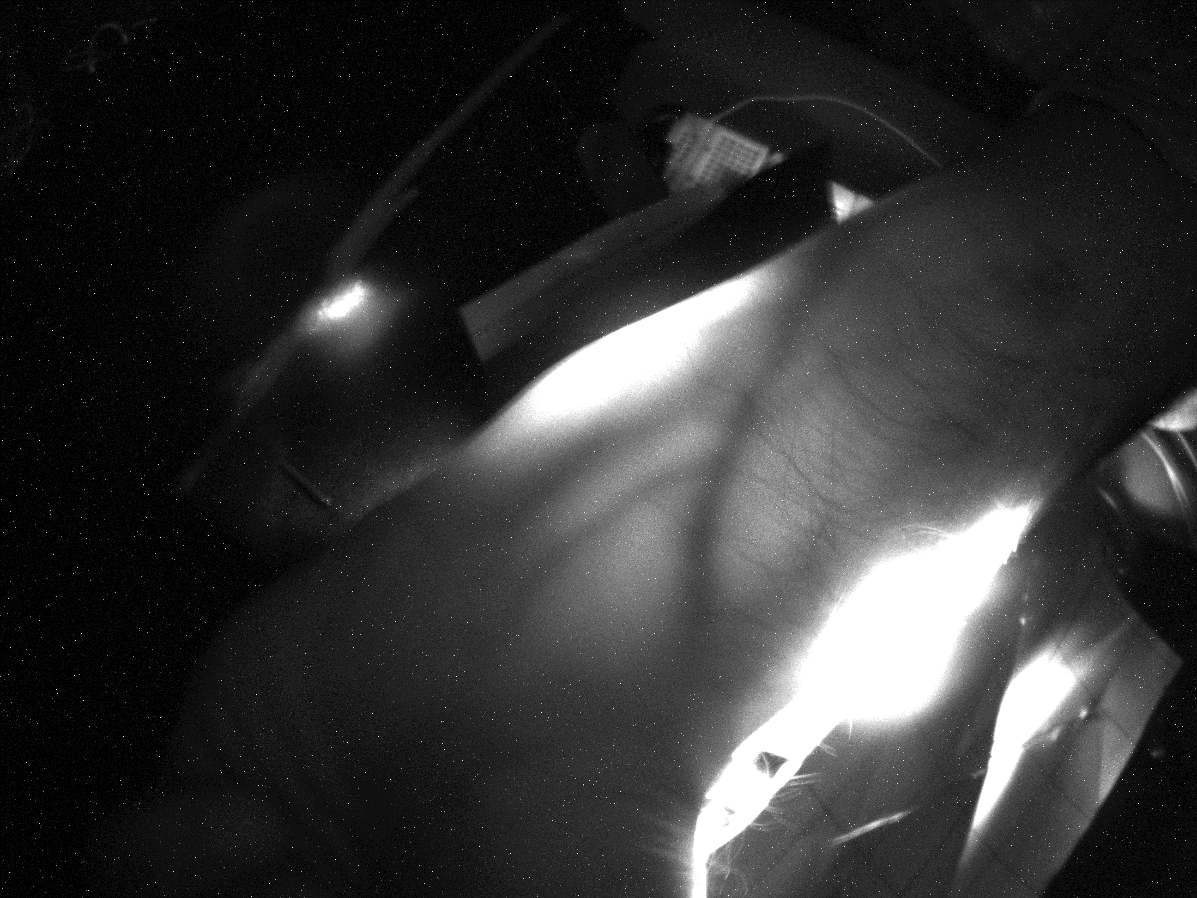
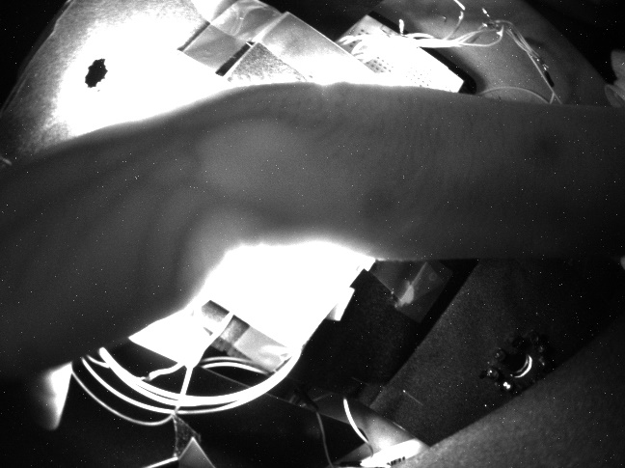
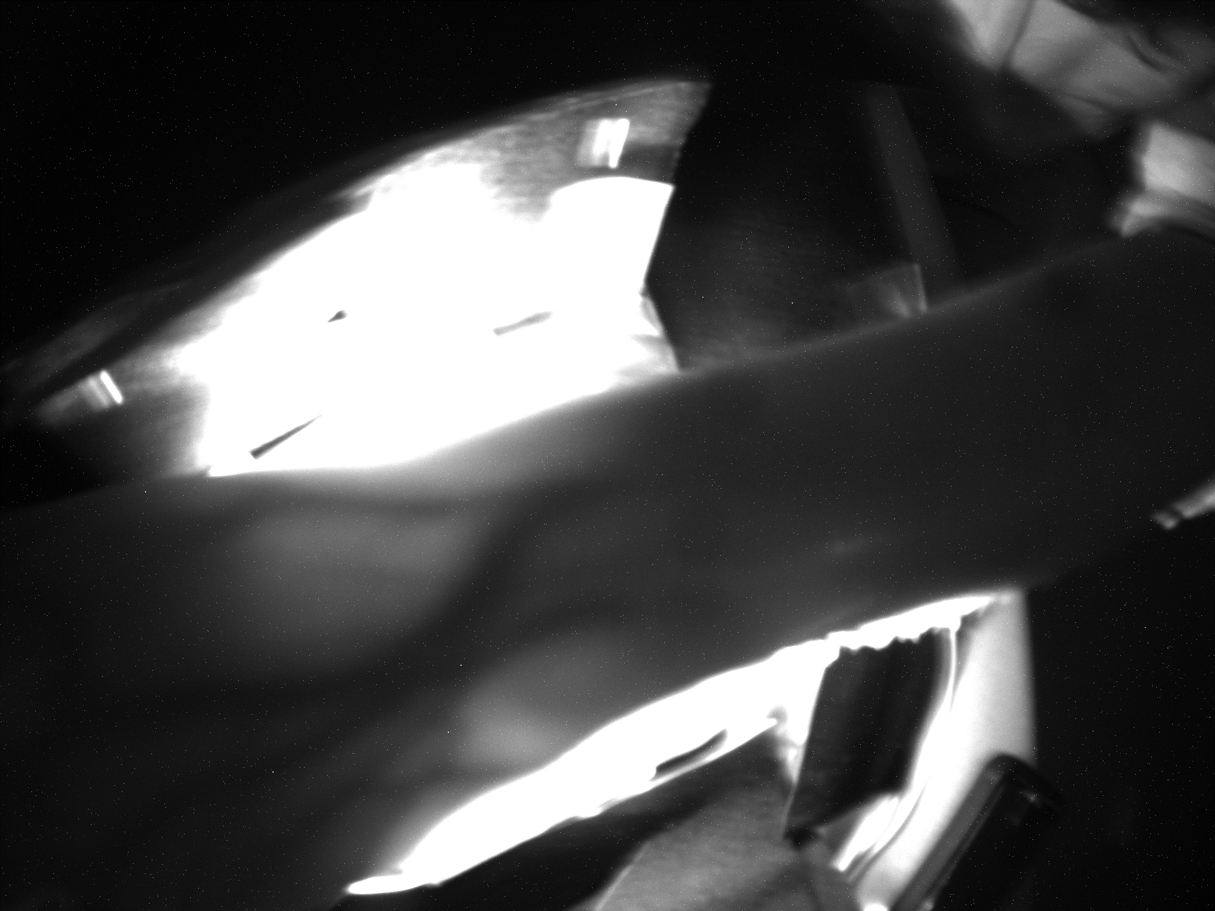
NIR Captured Images - Wrist
Exposure: 280081.130 µs
Gain: 2.4dB
Veins
Wrist at 70 degrees
Wrist at 89 degrees
IR refracted images of back side of the wrist with high intensity IR light on bottom side of hand
Wrist at 90 degrees
Wrist at 80 degrees

Slide 10
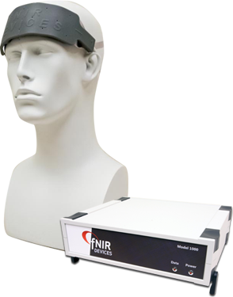
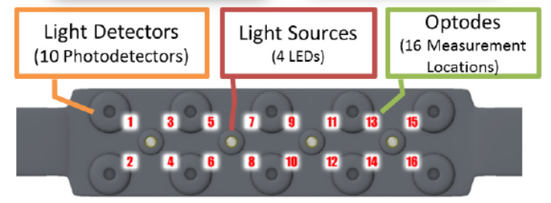
fNIR System
The LEDs are activated one at a time in sequence. Each time an LED is activated, the four detectors surrounding it are sampled. The sensors measure the light that is reflected back from the red blood cells through the scalp and skull. The arrangement of the four LEDs and 10 sensors, results in the data being collected in 16 channels. For each of the 16 measurements, fNIR shows the level of HbO in red and of HbR in blue.

Slide 11
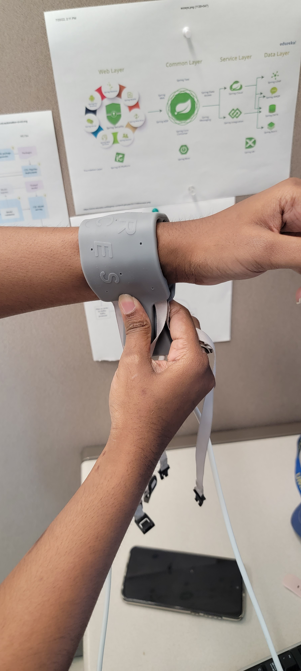
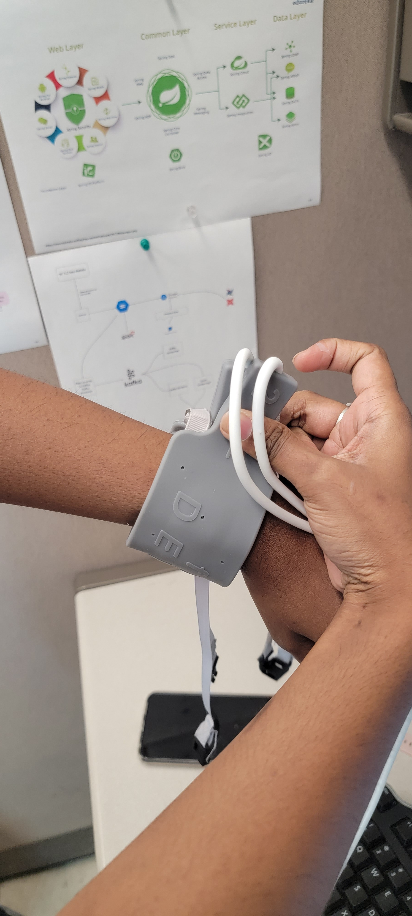
fNIR Setup:
Sensors and LEDs covering the Top side of the wrist
Sensors and LEDs covering the
bottom side of the wrist

Slide 12
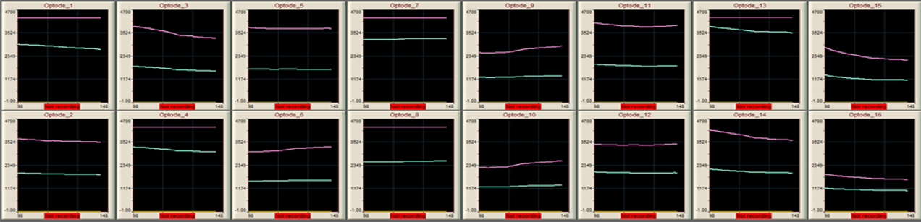
fNIR Image (Top side of wrist)
Red line – NIR data at 850 nm
Green line – NIR data at 730 nm
COBI Studio software collects raw fNIR signals for 16 channels and 2 wavelengths and transmit them through Ethernet or wireless network (via TCP/IP) to the Protocol Computer.

